Slide 1
COMP721 Web Development Lab 7 (Week 8)

Slide 2
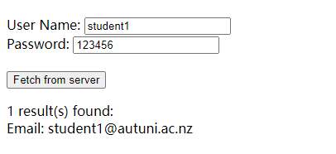
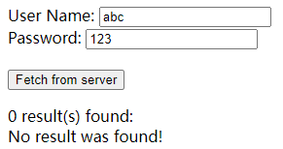
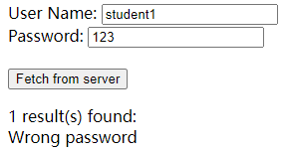
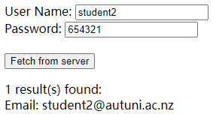
Please include this table when submitting this lab…
Test cases | Sample case | Expected outcome | Actual outcome
Correct combination of name and password | Name: “student1” Password: “123456” | Email: student1@autuni.ac.nz
Name not in the database | Name: “abc” Password: “123” | No result was found!
Name in the database, but the password is wrong | Name:”student1” Password:”123” | Wrong Password!
Correct combination of name and password | Name: “student2” Password: “654321” | Email: student2@autuni.ac.nz
Please be extra careful when copying and pasting code from a pdf

Slide 3
Lab 7 (due by the end of Week 10)
You only have ONE chance to submit your work, so please thoroughly test your programs BEFORE submitting.
To submit, you must send us an email with the following details:
Subject: COMP721 Lab 7
Body: For Lab 7, please include the following:
A test plan for your program (a template can be found on the previous slide)
A link to your lab07 folder in the form of
http://<Your AUT Network Login>.cmslamp14.aut.ac.nz/lab07
For example: http://zwz0468.cmslamp14.aut.ac.nz/lab07
Our contact details:
Lei Zhou: Lei.Zhou@aut.ac.nz
Alan Zhang: Yuqi.Zhang@autuni.ac.nz
Nancy Wang: Nancy.Wang@autuni.ac.nz
Note that we are only available on Teams during the lab sessions. For any questions raised outside the timeframe, please email us.

